Slide 1

Module 5: Identifiers, signals, constants, variables and types in VHDL
OHIO UNIVERSITY – SCHOOL OF EECS – EE5143 – DIGITAL DESIGN WITH VHDL AND VSLI

Slide 2
Identifiers and reserved words in VHDL
Valid identifiers in VHDL
A VHDL program consists of words that are either VHDL reserved words (such as, ‘entity’, ‘architecture’, ‘begin’, ‘end’ etc. or names defined for data objects, processes etc. by the programmer. These later names are called identifiers.
An identifier starts with a letter followed by any number of letters or digits. An underline character can be used between a letter or digit and the following letter or digit. Two or more underline characters cannot be used together neither can an identifier end with an underline character.
As mentioned before, VHDL is a case-insensitive language thus lower and upper cases letters are not distinguished. Therefore, AbC7 is considered the same identifier as aBC7. Also, spaces are not allowed in identifiers.

Slide 3
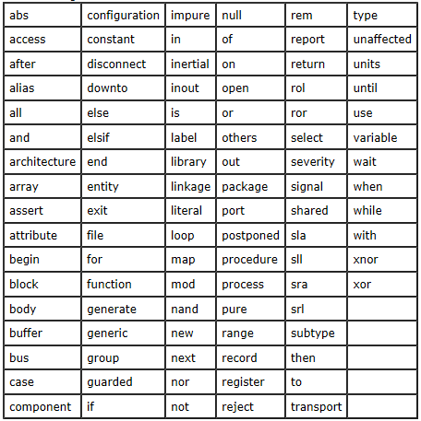
Identifiers and reserved words in VHDL
Reserved words in VHDL

Slide 4
Data objects in VHDL
Signals in VHDL
Software programming languages usually have two fundamental data objects: variables and constants. There are then several types of each of these objects. VHDL, in contrast has a third data object called signal. A signal is the analog of a physical wire that can carry electrical signals and connect inputs and outputs of logic circuits. Signal data objects can be of the same types as constants or variables but they differ from them because their actual assignment is scheduled and not immediate. Signal assignments are performed by using the ‘<=‘ rather than ‘:=‘ assignment operator.
A signal can be of any valid VHDL data type such as integer, bit, bit vector etc. It is mostly seen as being of type std_logic (essentially the same as bit) or std_logic_vector (essentially the same as bit vector).
A typical signal declaration might look like this:
signal procval : std_logic_vector(3 down to 0);

Slide 5
Data objects in VHDL
Constants in VHDL
Like in other programming languages, a constant in VHDL is a data object of a given type with a fixed value that, once defined, cannot be changed anywhere else in the program.
A typical constant declaration might look like this:
constant buswidth : integer := 8;

Slide 6
Data objects in VHDL
Variables in VHDL
A variable in VHDL, like a constant, is a typed data object whose value can be changed as needed. A variables can have an initial value defined in the same statement as it is declared but this is not necessary.
If no initial value is defined then that variable should not be used on the right-hand-side of a variable assignment expression until it has been assigned a definite value.
A typical variable declaration might look like this:
variable count : integer := 32;
Variable assignment statements use the assignment operator ‘:=‘ and typical assignment statements may look like:
count := 7; (an integer is value is assigned)
count := numspec; (another variable’s existing value is assigned);
count := memconstant; (a constant’s value is assigned);

Slide 7
Types in VHDL
Data types in VHDL
VHDL is a so-called strongly-typed language. This means that VHDL data objects have definite data types associated with them at the time they are declare. What is more, there is strict type checking such that assignments can only be done when the data object at the left-hand- side matches in type with the expression or data object on the right- hand-side of the assignment statement. If this is not observed during code writing then the VHDL compiler will flag it as an error and not compile the program.
Data types can be either Scalar types or Composite types. Scalars are simple data objects that have an order on the basis of which they can be used with relational operators (>, <, = etc). There are four categories of scalar types: enumeration, integer, floating and physical.
bit or std_logic are pre-defined enumeration types that can have values logic 0 and logic 1 (simply written as 0 or 1). std_logic can have other types of values as well which are less frequently used, especially for synthesis.

Slide 8
Types in VHDL
Data types in VHDL
Composite type data objects can hold more than one data value simultaneously. Examples are arrays and records.
Std_logic_vector is an example of an array type.
Arrays are simply declared by enclosing their index values in parenthesis (more than one dimension can be separated by commas)., followed by the data type.
An example is as follows:
type mainarray is array (0 to 31, 0 to 7) of std_logic;

Slide 9
Types in VHDL
Data types in VHDL
A record type is a composite type where each member data object can be of a different type (in array all data objects have to be of the same type). The different members of a record with different associated types are called fields of the record. Any individual fields of a record can be used in a program by using a dot (.), as is seen below.
type memblock is record
count : std_logic;
in_mem_buf : std_logic_vector (7 down to 0);
out_mem_buf : std_logic_vector (7 down to 0);
end record;
signal my_block : memblock;
my_block.count <= ‘1’;

Slide 10
Types in VHDL
Sub-types in VHDL
A type’s range can be further constrained by defining a sub-type. For example, from type integer one can define a sub-type called byte_size which is an integer in the range of 0 to 255. A variable can then be defined of this sub-type:
type byte-size is integer range 0 to 255;
signal my_int : byte_size;
In this case an error will be reported if my_int is assigned a value out of the 0 to 255 range.

